Slide 1
Orchestration
Model
Discovery
References
Resources

Slide 2
Service Discovery
In code
Named endpoints
By reference

Slide 3


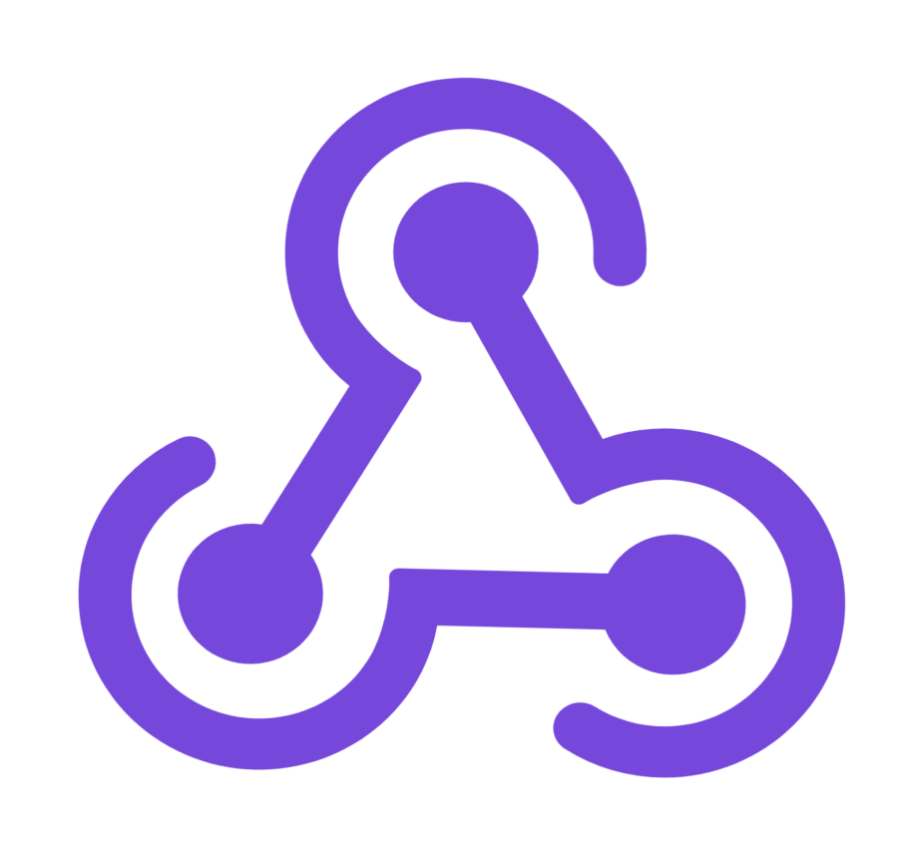

Microservices
Cloud Services
Identity Service
Client Apps
Identity API
Mobile App
Mobile API
Catalog Service
Catalog API
Ordering Service
Event Bus
Browser
Ordering API
Web App
Order processor
Basket Service
Basket API
Admin Services
Webhook Client
Observability
Webhooks API

Slide 4
SOA
Cloud Services
Customer
Client Apps
Mobile App
Mobile API
Order
Service Bus
Payment
Browser
Web App
Reporting
Data

Slide 5
Modular Monolith
App hosting
App
Customer
Client Apps
Mobile App
Mobile API
Order
Payment
Browser
Web App
Reporting
Data

Slide 6
Monolithic server process
Modules
Data
Customer
Client Apps
Mobile App
Mobile API
Order
Payment
Browser
Web App
Relational database
Identity
Catalog

Slide 7
Server-based
Server
Client Apps
App
Customer
Order
Payment
Reporting
Data
Mobile App
Browser
App
Customer
Order
Payment
Reporting
Data

Slide 8
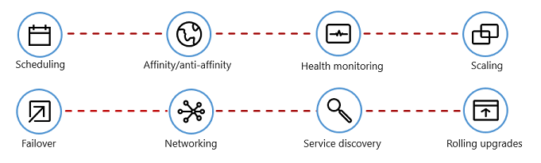
Scheduling
Affinity
Health monitoring
Scaling
Failover
Networking
Service discovery
Rolling upgrades

Slide 9
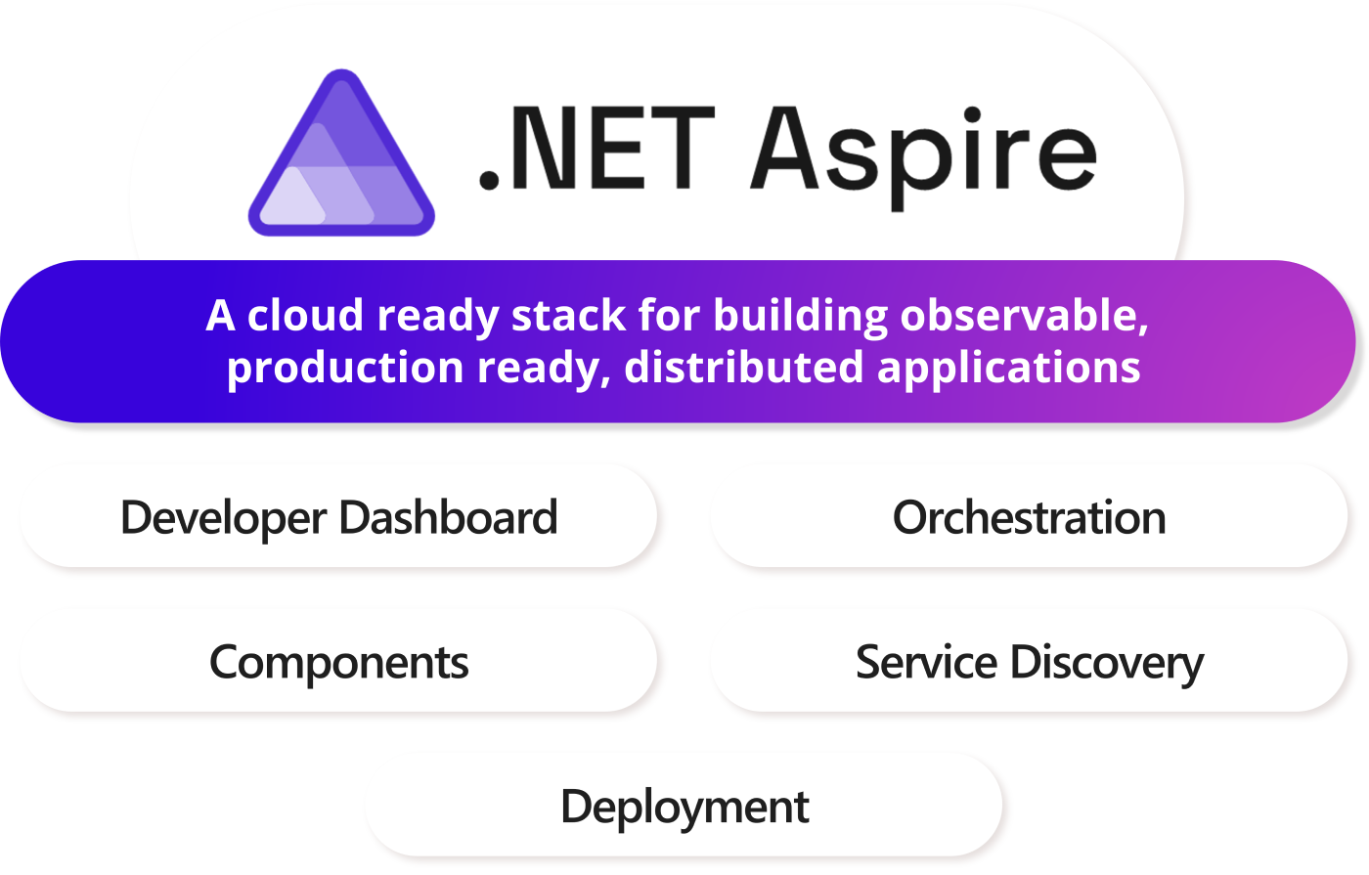
Integrations

Slide 10
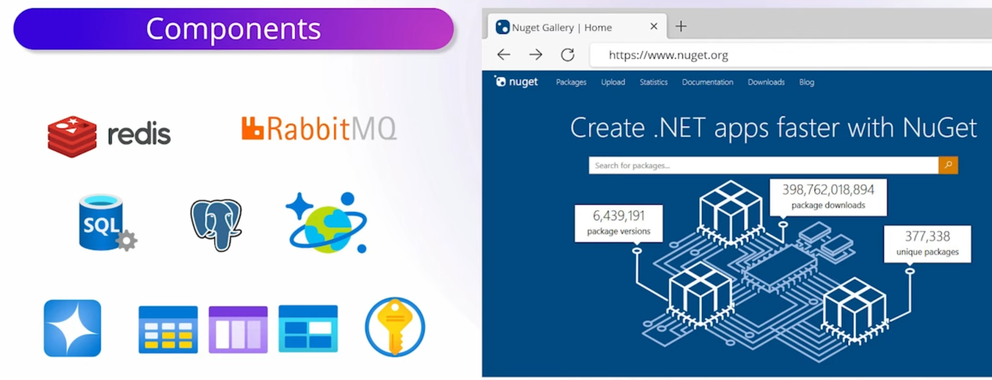
Integrations

Slide 11


Migrate
Modernize
Containerize
Existing apps & services .NET Framework on-premises
Rehost
Cloud Infrastructure Ready apps
Cloud Optimized apps
Cloud-Native apps
Rearchitect & Rebuild
On-Premises Infrastructure Platform
IaaS Lift & shift
Containers & PaaS
Microservices & Serverless
No code changes
Rewrite

Slide 12
Containers
Backing Services
Microservices
Cloud-Native App
Automation
Modern Design

Slide 13
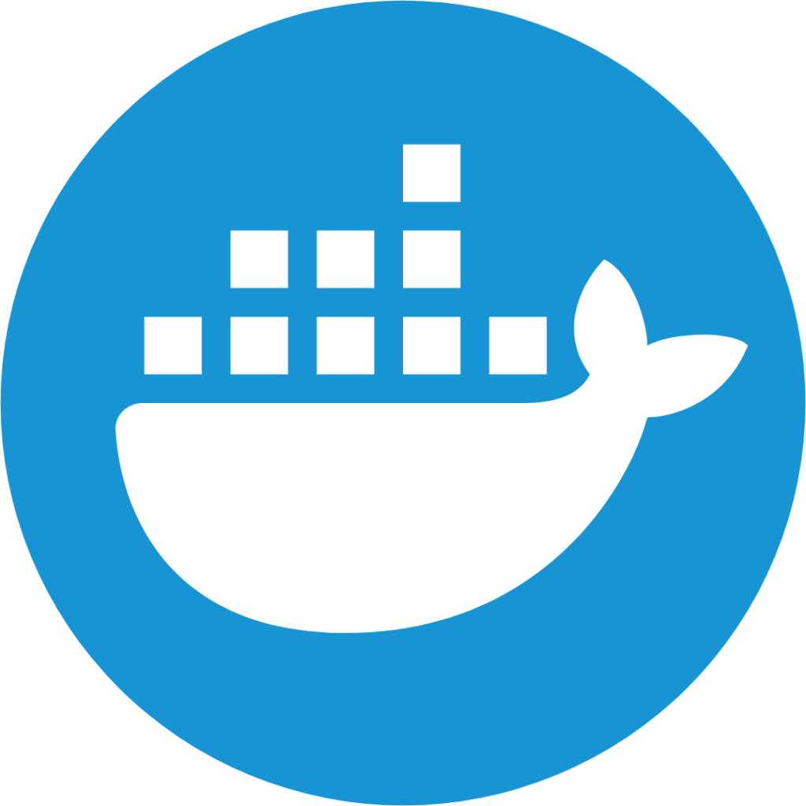
Host Machine
Product:1.0
Basket:2.0
Product:2.0
Product:API v1.1
Basket:API v4
Product:API v2
Lib-L v2
Lib-L v3.1
Lib-L v3
Lib-M v9
Runtime v5
Runtime v7
Runtime v6
Host OS

Slide 14
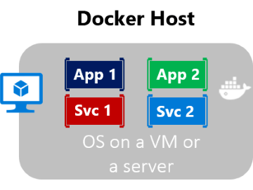
Docker Host
App 1
App 2
Service 1
Service 2

Slide 15



VM 1
VM 2
App1
App2
Bins/Libs
Bins/Libs
Guest OS
Guest OS
Hypervisor
Host OS
Infrastructure

Slide 16
Registry
Stores many static images
Hosted Docker Registry
Docker Trusted Registry on-prem
Docker Hub Registry
Docker Trusted Registry on cloud
Azure Container Registry
Google Container Registry
Quay Registry
Other Cloud
On
Premises
Images
Static, persisted container image
Static, persisted container image
Static, persisted container image
Static, persisted container image
Public
Cloud
Container
Image instance running an app process

Slide 17
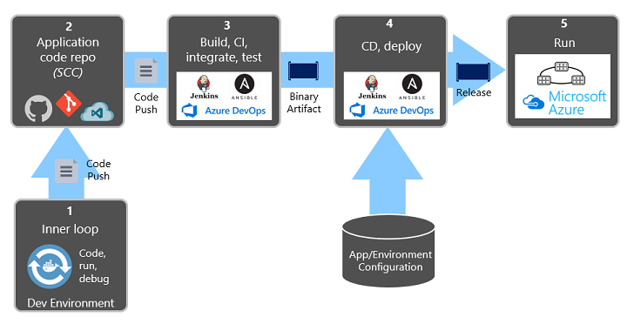


Code, run, debug
Dev Environment
1
Code Repo
2
Build, CI, integrate, test
3
CD & deploy
4
Run
5
Push
Push
Binary
Release
App/Environment Configuration

Slide 18
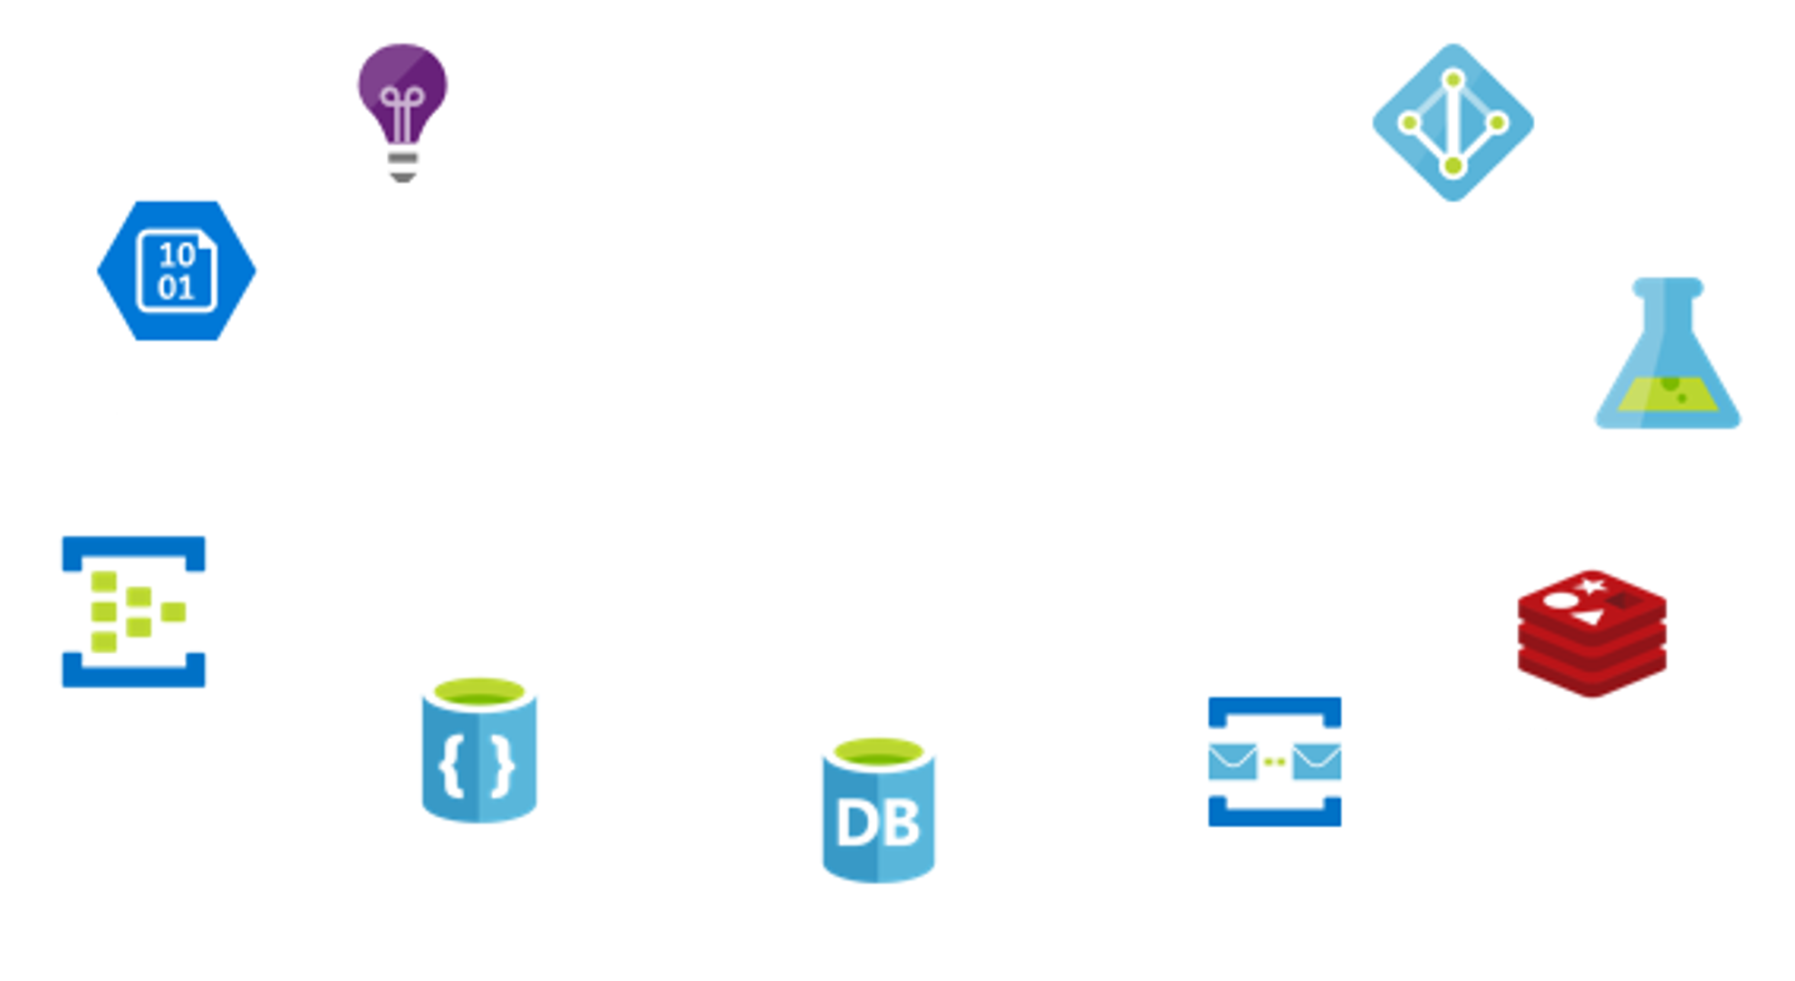
Monitoring
Security
Storage
Analytics
Cloud-Native System
Streaming
Caching
NoSQL
Messages
Relational

Slide 19
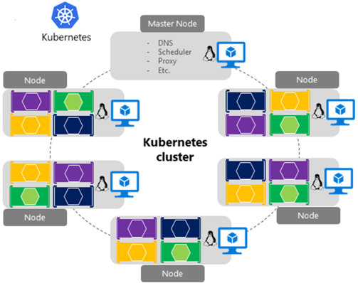

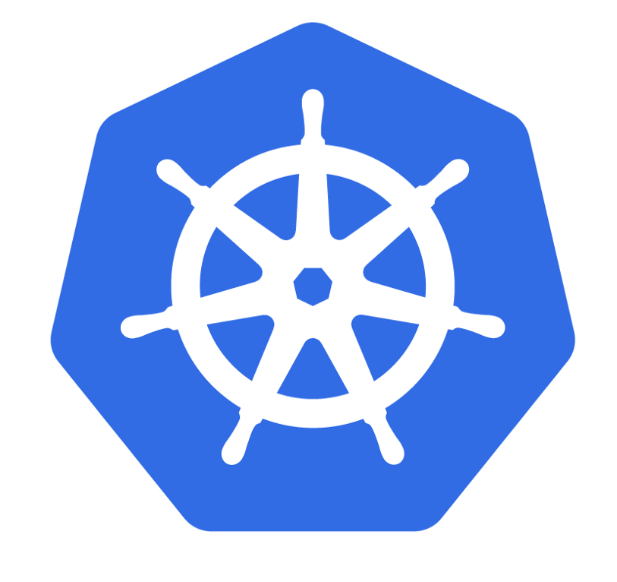
Master Node
- DNS - Scheduler - Proxy
Node
Node
Kubernetes
cluster
Node
Node

Slide 20
Microservice
Microservice
Sidecar Proxy
gRPC
Sidecar Proxy
HTTP
HTTP
Microservice
Microservice
Microservice
gRPC
HTTP
Sidecar Proxy
Sidecar Proxy
Sidecar Proxy
gRPC
gRPC
Microservice
Microservice
Sidecar Proxy
HTTP
Sidecar Proxy

Slide 21
Control Plane
C#
Java
Golang
Microservice
Microservice
Microservice
Sidecar Proxy
HTTP
Sidecar Proxy
gRPC
Sidecar Proxy
Data plane

Slide 22
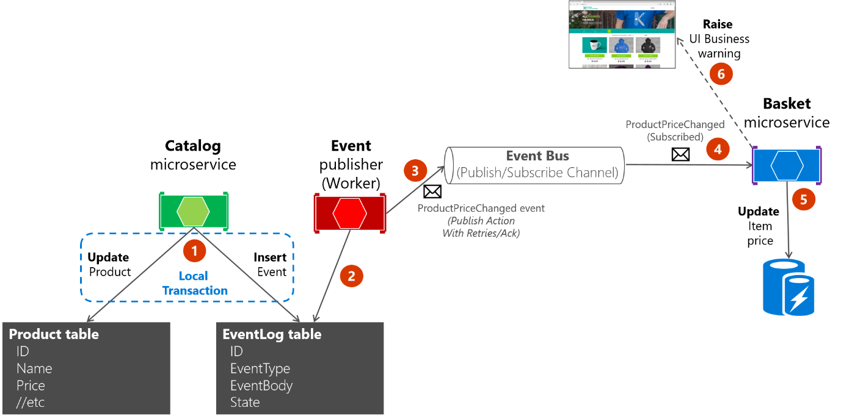

Slide 23
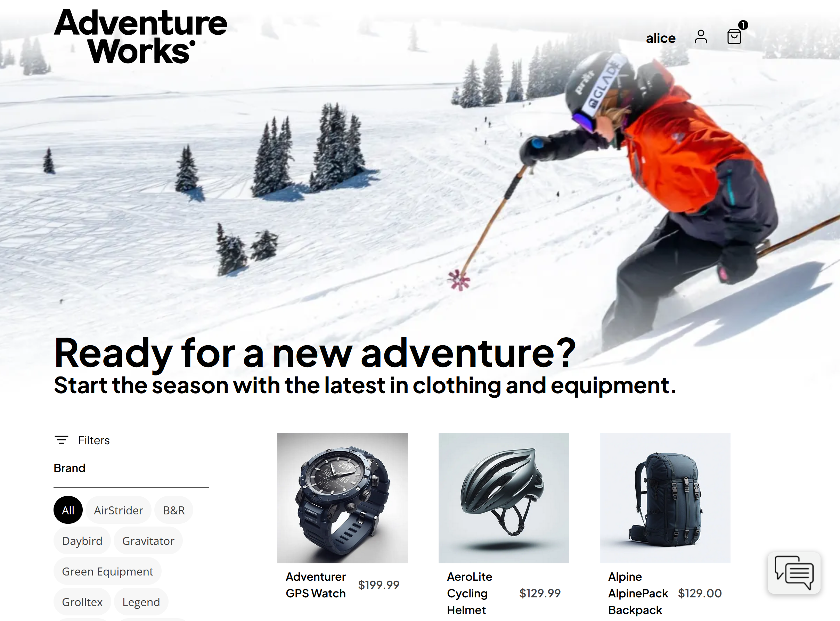
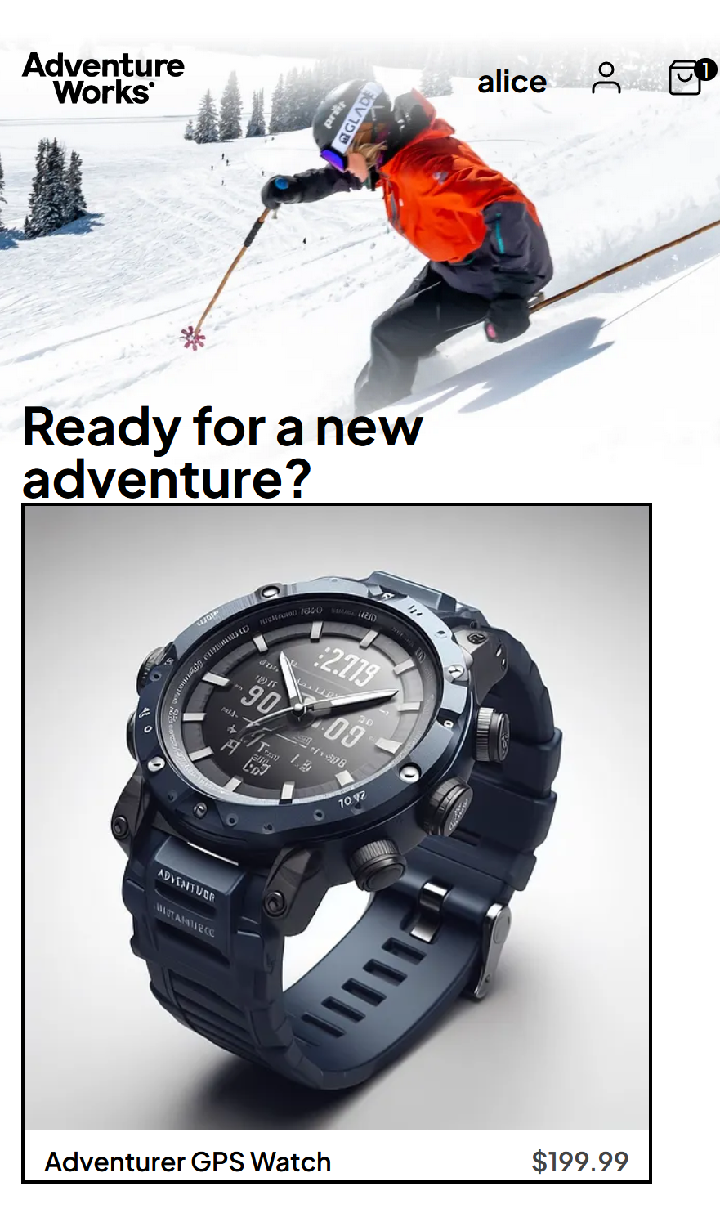
Shared Services
Microservice
Service
Single shared relational database
Microservice
Service
Microservice
Service
Monolithic
Cloud Native

Slide 24
Catalog Service
Catalog API
Ordering Service
API Gateway
Ordering API
Order processor
Basket Service
Basket API

Slide 25
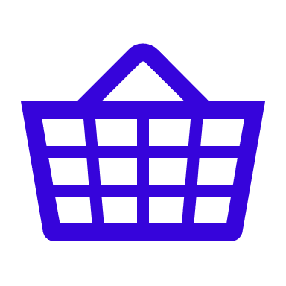

Basket Service
Catalog Service
Product
Basket
Owned by
Line Item
Product
Pricing Service
Price
Owned by
Price

Slide 26

Basket Service
Catalog Service
Product
Basket
Syncs Pub/Sub
Line Item
Syncs Pub/Sub
Pricing Service
Product/pricing
read model
Denormalized
data
Price

Slide 27
Catalog Service
Payment Service
Inventory Service
Shipping Service
Notification Service
Create pending order
Validate payment
Update inventory
Source shipment
Send
invoice
Complete order

Slide 28


Catalog Service
Payment Service
Inventory Service
Shipping Service
Notification Service
Create pending order
Validate payment
Update inventory
Source shipment
Send
invoice
Cancel
order
Cancel
payment
Adjust inventory
Complete order

Slide 29
Consistency
Availability
RDMS
Partition
tolerance
NoSQL

Slide 30
Cloud Services
Simple CRUD
microservices
Client Apps
Microservice 1
Web API
Mobile App
Microservice 2
Simple CRUD
Implementation
Web API
SPA Web App
API gateway
Microservice 3
Internal design
patterns
per microservice
Web App
Web API

Slide 31
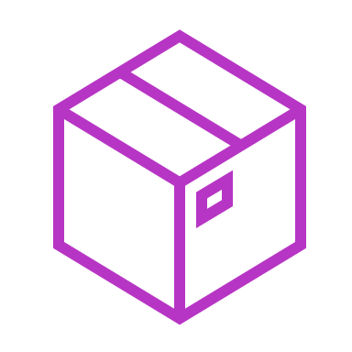
Docker host
Logical Catalog Microservice
Container
Catalog
Database
External IP
and port
Internal IP
and port
Web API:
Controllers
Data Access
SQL Server

Slide 32
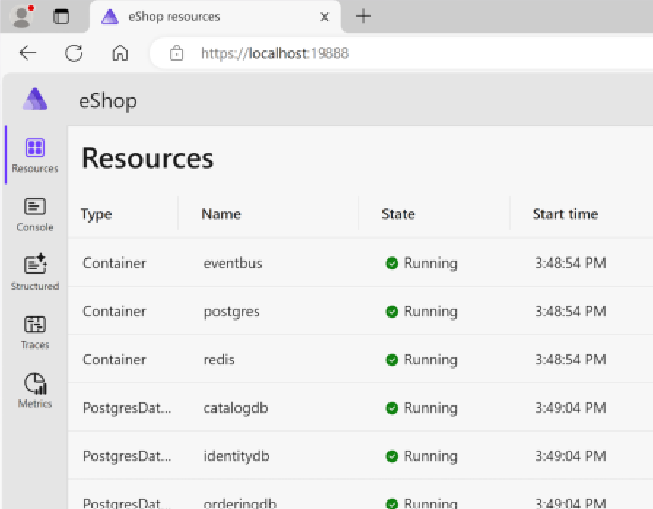
Dashboard
App 1
OLTP
App 2
gRPC Protocol
Resource
Console logs
Command execution
Resource Server

Slide 33
Cloud Services
Direct
client-to-service communication
Microservice 1
Client Apps
Web API
Mobile App
Microservice 2
Web API
Web App
Microservice 3
Web API

Slide 34
Cloud Services
API gateway pattern
Microservice 1
Client Apps
Web API
Mobile App
JSON
Microservice 2
API gateway
Web API
SPA Web App
JSON
Microservice 3
Web App
Web app
Web API
HTML

Slide 35
Cloud Services
Backend for frontend pattern
Client Apps
Microservice 1
Web API
Mobile App
JSON
API gateway
Microservice 2
Web API
Desktop App
JSON
API gateway
Microservice 3
Web App
HTML
Web app
API gateway
Web API

Slide 36
Cloud Services
Azure Application Gateway
Azure Kubernetes Service Cluster
Client Apps
Microservice 1
Web API
Mobile App
Ingress Rules
Microservice 2
Web API
Desktop App
JSON
Azure Application Gateway
Ingress Controller
Microservice 3
Web App
Web API

Slide 37


Cloud Services
Azure API Management
Azure API Management
Developers
Developer
Portal
Microservice 1
Web API
Apps
API Gateway
Microservice 2
Data Center
Administrators
Publisher
Portal
Web API

Slide 38

Cloud Services
Azure
SignalR
Client SPA Web Apps
SPA Web App 1
Persistent
Connection
SignalR Service Hub
JavaScript
Angular
Service
SPA Web App 2
Message to
communicate
Persistent
Connection
JavaScript
Angular

Slide 39
Cloud Services
Direct HTTP communication
Product Catalog Microservice
Web API
Client Apps
2. Product lookup
http://
Mobile App
Shopping Basket Microservice
JSON
API gateway
1. Add item
Web API
http://
3. Price lookup
http://
SPA Web App
JSON
Pricing Microservice
Web API

Slide 40
Cloud Services
Direct HTTP communication
API gateway
1. Add item
Shopping Basket
Microservice
http://
Web API
Client Apps
2. Product
lookup
http://
Mobile App
Product Catalog
Microservice
3. Price
lookup
JSON
Pricing
Microservice
Web API
http://
Web API
4. Create
order
http://
Product Catalog
Microservice
5. Find carrier
8. Lookup
customer
Web API
SPA Web App
JSON
http://
7. Check
stock
http://
http://
Shipping
Microservice
6. Lookup
Product Catalog
Microservice
Customer
Microservice
Web API
http://
Web API
Web API

Slide 41
Cloud Services
Service aggregator
pattern
Shopping Basket
Microservice
Client Apps
Add item
Checkout Aggregator
Microservice
Web API
http://
Mobile App
JSON
Web API
Product lookup
Product Catalog
Microservice
http://
Add item
http://
Web API
Price
lookup
SPA Web App
API gateway
JSON
http://
Pricing
Microservice
Web API

Slide 42
z
Cloud Services
Request-reply
pattern
Request message
Product ID = 557
Correlation ID = xyz
Shopping Basket Microservice
Client Apps
2. Get price
request
Request queue
3.
Pricing
Microservice
Web API
Mobile App
Response queue
Web API
JSON
5. Get price
response
4.
Response message
Price = $3.98
Correlation ID = xyz
1. Add item
SPA Web App
API gateway
JSON

Slide 43
z
Cloud Services
Command interaction
with a queue
Ordering Microservice
Shipping Microservice
Client Apps
2. Get order
data
4. Schedule
shipping
Mobile App
3. Ship order
command
Queue
Web API
Web API
JSON
1. Prepare order
SPA Web App
JSON
API gateway

Slide 44
Storage account
Queue 1
Message 1
Message 2
Queue 2
Message 3

Slide 45
Service Bus
Consumer 1
Provider 1
Queue 1
Consumer 2
Provider 2
Message 1
Message 2
Message 3
Consumer 3

Slide 46
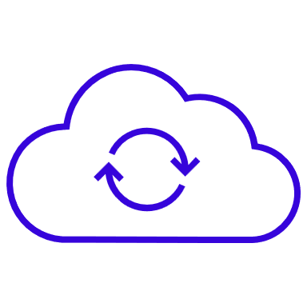
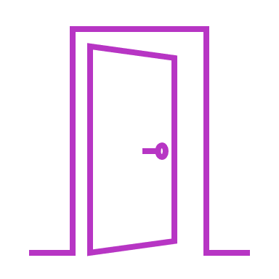
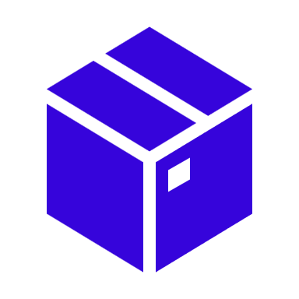

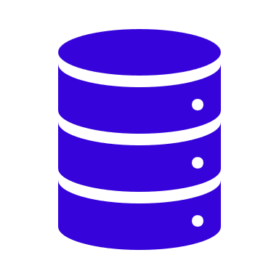
Internet
Gateway
Virtual Network
Azure Resources

Slide 47




Security principal
User
Group
Service
principal
Managed
identity

Slide 48
Monolithic
App
ASP.NET MVC app
UI Endpoints
Business Logic
Data Access Logic
Log file

Slide 49
Monolithic App
(scaled out)
Node 1
Node 2
Node 3
ASP.NET MVC app
ASP.NET MVC app
ASP.NET MVC app
UI Endpoints
UI Endpoints
UI Endpoints
Business Logic
Business Logic
Business Logic
Data Access Logic
Data Access Logic
Data Access Logic
Log file
Log file
Log file

Slide 50
Cloud Services
Local log file
per service
Microservice 1
Client Apps
Web API
Log file
Mobile App
UI Service
Web API
Microservice 2
Web API
Log file
SPA Web App
Log file
Microservice 3
Web API
Log file
Web App

Slide 51
Cloud Services
Centralized logging
1. Generate Correlation
ID
Microservice 1
Web API
2. Log with ID
UI Service
Client Apps
Web API
Mobile App
Microservice 2
2. Log with ID
Web API
2. Log with ID
SPA Web App
3. Log to centralized store
Centralized
Log Store
Web App

Slide 52
Cloud Services
Distributed cloud-native environment
Microservice 1
Client Apps
Web API
Mobile App
JSON
Microservice 2
API gateway
Web API
SPA Web App
JSON
Microservice 3
Web App
Web app
Web API
HTML

Slide 53


Cloud Services
Retry pattern
Polly
Resiliency Configuration
Client Apps
Retries: 4
Duration: 2 secs
Mobile App
1
Microservice
JSON
500
Web API
API gateway
2
SPA Web App
JSON
500
3
200
Web App
HTML
Web app

Slide 54
Cloud Services
Circuit breaker
pattern
Polly
Resiliency Configuration
Retries: 4
Duration: 2 secs
Exceptions Allowed: 100 Check Circuit: 30 secs
1
Client Apps
500
2
Mobile App
429
Microservice
JSON
…
Web API
API gateway
408
SPA Web App
JSON
10
408
Web App
Web app
Circuit open
Call to microservice fail immediately
Allow one call every 30 secs to check state
HTML

Slide 55
Backend
Catalog Microservice
Basket Microservice
4. PriceUpdated
event
Web API
Event bus
Publish/subscribe
channel
Service
Database
as cache
1. UpdatePrice
command
3. UpdatePrice
event
2. DB
update
Event bus implementations:
RabbitMQ
Azure Service Bus
Other message/event broker
Additional Microservices
Service
Database
Eventual consistency between microservices based on event-driven async communication

Slide 56

Microservice B
Microservice A
Event bus
Publish/
subscribe
channel
2. Event
1. Publish event
Microservice C

Slide 57
Event bus
Publish/subscribe channel
Event bus abstractions/interface
Event bus implementations
Rabbit MQ
Azure Service Bus
Other message / event broker

Slide 58
Cloud
Shopping Basket Microservice
Ordering Microservice
API gateway
Web API
Event bus
Publish/subscribe channel
Service
1. Checkout
command
3. Checkout
event
4. Checkout
event
2. DB
update
Event bus abstractions/interface
Database
Event bus implementations
Rabbit MQ
Azure Service Bus
Other message / event broker
Inventory Microservice
Service
Database

Slide 59

Filtering rules
GetPriceRule
Price
subscribers
Publisher 1
Topic
Price subscription
GetInfoRule
Info
subscriber
Publisher 2
Info subscription
LogRule
Log
subscriber
Logging subscription

Slide 60
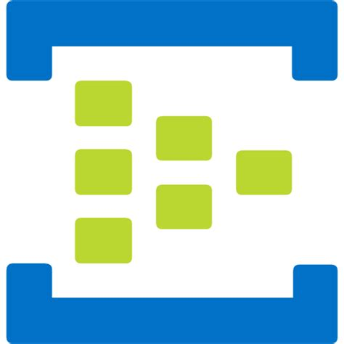
Event
producer
Event consumer
Event
producer
Event consumer
Event
producer
Event consumer
Event Hub

